Slide 1
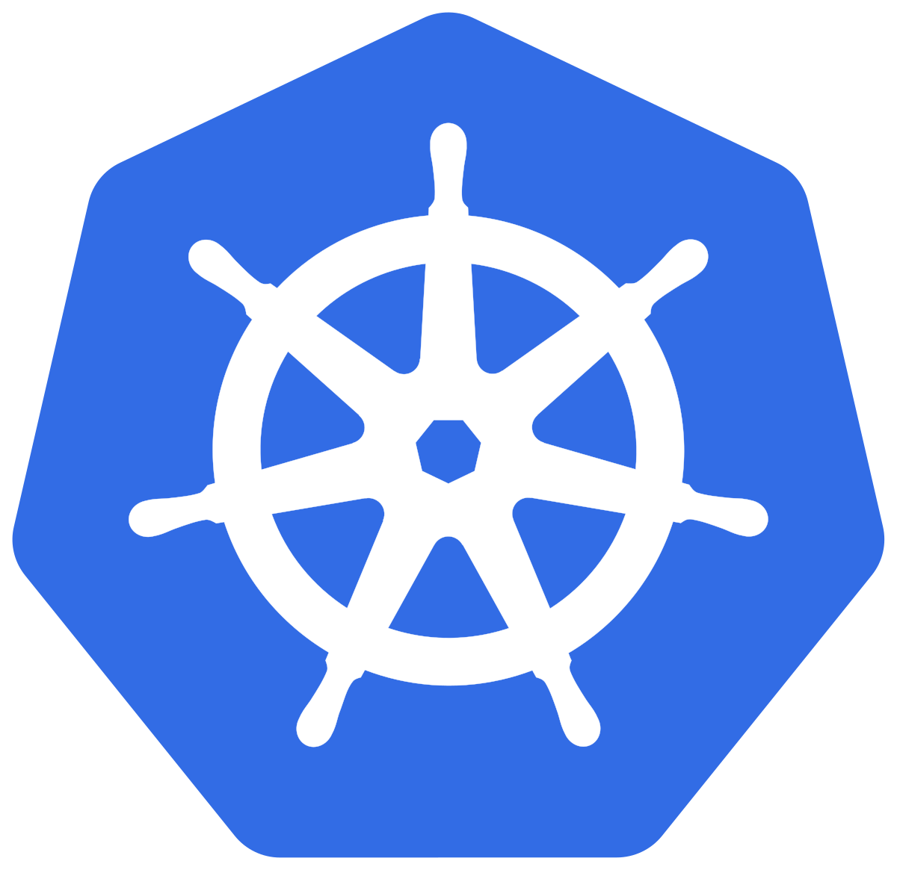
K8s basics

Slide 2
What is kubernetes?
Based on Google's Borg cluster manager, Kubernetes is an open source container-orchestration system for automating application deployment, scaling, and management. Kubernetes API is portable, extensible and open-source, that facilitates both declarative configuration and automation.

Slide 3
What problem does kubernetes solve?
With the adoption of containers for application deployments and the layered CoW image standard given by Docker, the industry had to solve different problems that come with the containers.
In a production environment, you need to manage the containers that run the applications and ensure that there is no downtime. For example, if a container goes down, another container needs to start.
If a container needs a volume, how would it be managed? What if I want to run containers between multiple hosts?
All these and more problems were solved by kubernetes.

Slide 4
Kubernetes provides you with:
Service discovery and load balancing
Storage orchestration
Automated rollouts and rollbacks
Automatic bin packing
Self-healing
Secret and configuration management

Slide 5
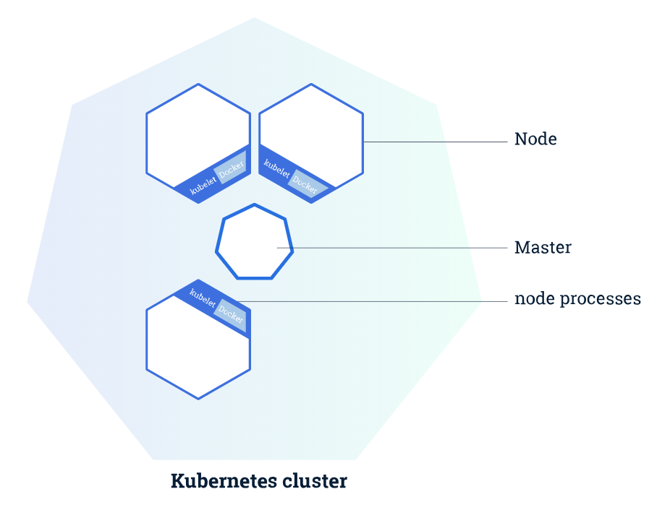
Architecture

Slide 6
Master components
Etcd: is a consistent and highly-available key value store used as Kubernetes’ backing store for all cluster data. It uses the Raft algorithm.
Kube-apiserver: is a component of the Kubernetes control plane that exposes the Kubernetes API. The API server is the front end for the Kubernetes control plane
Kube-scheduler: Component on the master that watches newly created pods that have no node assigned, and selects a node for them to run on.

Slide 7
Kube-controller-manager: Component on the master that runs controllers.
Node controller
Replication controller
Endpoints controller
Service account and token controllers
Cloud-controller-manager: Daemon that embeds cloud-specific control loops.
Google Cloud Platform
Amazon Web Services
Digital Ocean
Rancher

Slide 8
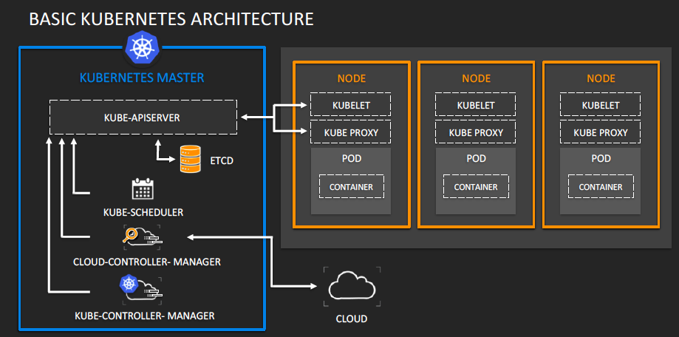

Slide 9
Node components
Kubelet: An agent that runs on each node in the cluster. It makes sure that containers are running in a pod.
Kube-proxy: maintains network rules on nodes. These network rules allow network communication to your Pods from network sessions inside or outside of your cluster.
Container Runtime Interface: is the software that is responsible for running containers.

Slide 10
Different flavours
Since Kubernetes itself is an application, you can decide either run it on physical instances, VMs or even containers. You can then decide to run it on your infrastructure

Slide 11
Addons
DNS
Dashboard
Container Network Interface
Container resource monitoring
Cluster level logging

Slide 12
Objects
Pod: is the smallest deployable unit of computing that can be created and managed in Kubernetes. A pod is a group of one or more containers (such as Docker containers), with shared storage/network, and a specification for how to run the containers.
Deployment: provides declarative updates for Pods and ReplicaSets.
StatefulSets: Manages the deployment and scaling of a set of Pods, and provides guarantees about the ordering and uniqueness of these Pods. StatefulSets are valuable for applications that require one or more of the following:
Stable, unique network identifiers.
Stable, persistent storage.
Ordered, graceful deployment and scaling.
Ordered, automated rolling updates.

Slide 13
Objects
DaemonSets:A DaemonSet ensures that all (or some) Nodes run a copy of a Pod. As nodes are added to the cluster, Pods are added to them. As nodes are removed from the cluster, those Pods are garbage collected. Deleting a DaemonSet will clean up the Pods it created.

Slide 14
Services
ClusterIP: Exposes the Service on a cluster-internal IP. Choosing this value makes the Service only reachable from within the cluster.
NodePort: Exposes the Service on each Node’s IP at a static port (the NodePort).
LoadBalancer: Exposes the Service externally using a cloud provider’s load balancer.
ExternalName: Maps the Service to the contents of the externalName field (e.g. foo.bar.example.com), by returning a CNAME record.

